Slide 1
Synchronous and Asynchronous
Transmission

Slide 2
Asynchronous and Synchronous Transmission
For exchanging data between two devices by a transmission medium, high degree of co-operation is required between the transmitter and the receiver.
There are different data transmission modes:

Slide 3

Figure 4.31 Data transmission and modes
4.<number>

Slide 4

Figure 4.32 Parallel transmission
4.<number>

Slide 5

Figure 4.33 Serial transmission
4.<number>

Slide 6
Asynchronous and Synchronous Transmission
In serial transmission data are transmitted one bit at a time over the medium.
The timing(rate ,duration, spacing) of these bits must be same for the transmitter and receiver.
Two common techniques for controlling this timing:
        Asynchronous
        Synchronous

Slide 7
Asynchronous and Synchronous Transmission
In serial transmission of data ,data are transferred over a single signal path rather than a parallel set of lines.
  E.g. I/O devices and internal computer paths
The signaling elements are sent down the line.
Each signaling element may be:
  Less than one bit(Manchester Encoding)
  One bit(NRZ-L and FSK)
  More than one bit(QPSK)

Slide 8
Asynchronous and Synchronous Transmission
The reception of digital data involves sampling the incoming signal once per bit time to determine the binary value.
The transmission impairments may cause errors in the signal which is compounded by a timing difficulty.
i.e. for the receiver to sample the incoming bits properly ,it must know the arrival time and duration of each bit that it receives.
Suppose the sender is sending a stream of bits.
The sender has a clock that governs the timing of transmitted bits.

Slide 9
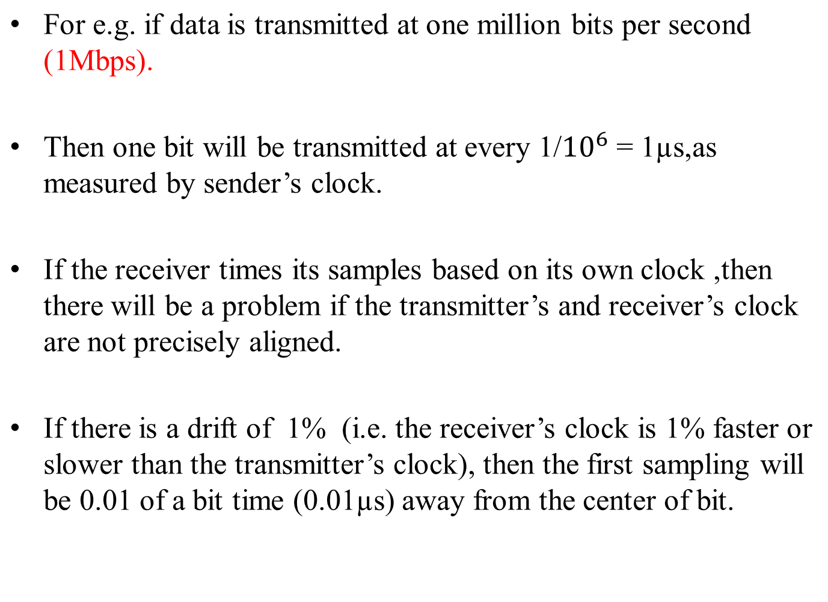
Asynchronous and Synchronous Transmission

Slide 10
Asynchronous and Synchronous Transmission
After 50 or more samples ,the receiver may be in error because it is sampling in the wrong bit time (50×0.01)=0.5µs
For smaller timing difference ,error would occur later
So this problem will occur when a long stream of bits are transmitted from the sender to the receiver.

Slide 11

Figure 4.3 Effect of lack of synchronization
4.<number>

Slide 12
Asynchronous Transmission
Asynchronous transmission is one method used for achieving synchronization.
In this strategy ,the timing problem is avoided by not sending long uninterrupted stream of bits.
Instead data are transmitted one character at a time where each character is 5 to 8 bits in length.
Timing or synchronization must only be maintained within each character
The receiver has the opportunity to resynchronize at the beginning of each new character.
Fig. shows this technique.

Slide 13

Figure 4.34 Asynchronous transmission
4.<number>

Slide 14
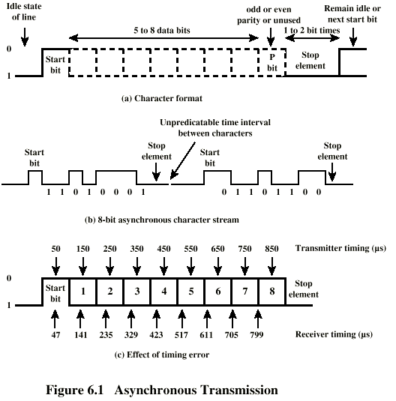
Asynchronous Transmission

Slide 15
Asynchronous Transmission
When no character is being transmitted ,the line between transmitter and receiver is an idle state.
The idle state is equivalent to the signaling element for binary 1 .
For NRZ-L signaling ,idle would be the presence of a negative voltage on the line
The beginning of a character is signaled by a start bit with a value of binary 0.
This is followed by 5 to 8 bits that actually makeup the character.

Slide 16
Asynchronous Transmission
The bits of the character are transmitted beginning with the least significant bit.
for IRA character coding, each character is represented by 7 bits plus one parity bit(which is in the most significant bit)
Parity bit is sent by the transmitter for error detection depending on convention used.
  Odd parity: the parity bit is set in such a way that the number of ones in the character plus the parity bit is odd.
  Even parity :the parity bit is set in such a way that the number of ones in the character plus the parity bit is even.

Slide 17
Asynchronous Transmission
The final element is a stop element ,which is a binary 1.
The minimum length for the stop element is 1,1.5 or 2 times the duration of an ordinary bit.
Because the stop element is same as the idle state, the transmitter will continue to transmit the stop element until it is ready to send the next character.
If the receiver is 5% slower or faster than the transmitter ,the sampling of the eighth character will be displaced by 45 % and still be correctly sampled.
Fig . Shows the effects of a timing error of sufficient magnitude to cause an error in reception.

Slide 18
Asynchronous Transmission
Let the data rate be 10,000 bits per second.(10 kbps)
Therefore each bit is of 0.1 milliseconds (ms) or 100 µs duration.
Assume that the receiver is fast by 6 % ,or 6 µs per bit time.
Thus the receiver samples the incoming character every 94 µs.
So the last sample is erroneous.

Slide 19
Asynchronous Transmission
This type of error results in two errors:
  First ,the last sampled bit is incorrectly received.
  Second ,the bit count may now be out of alignment .
  If bit 7 is 1 and bit 8 is a 0,bit 8 could be mistaken for a start bit.
  This condition is termed frame error.
  The character bits plus start bit and stop element is referred to as a frame.
  A framing error can also occur if some noise condition causes the false appearance of a start bit during the idle state.

Slide 20
Asynchronous Transmission
Asynchronous transmission is simple and cheap but requires an overhead of two to three bits per character.
For a 8-bit character with no parity, with one bit long stop element and one start bit, two bits of every 10 bits convey no information .
They are for only synchronization and thus the overhead is 20%.
This overhead can be reduced by sending larger blocks of bits between the start and stop bit.
But for larger block of bits ,the greater the cumulative timing error.

Slide 21
Synchronous Transmission
With synchronous transmission , a block of bits is transmitted in a steady stream without start and stop codes.
The block may be many bits in length.
To synchronize the transmitter and receiver,to prevent timing drift,two approaches are used .
One is to provide a separate clock line between the transmitter and the receiver.
Either transmitter or receiver pulses regularly with one short pulse per bit time.
The other side uses this regular pulses as clock.

Slide 22
Synchronous Transmission
This technique work well for short distances, but for long distances ,the clock pulse are subject to the same impairments as the data signals and timing errors can occur.
Second alternative is to embed the clocking information in the data signal.
In digital signals ,this can be achieved by Manchester Encoding and Differential Manchester Encoding.
For analog signals many other methods can be used.

Slide 23

Figure 4.35 Synchronous transmission
4.<number>

Slide 24
Synchronous Transmission
With synchronous transmission, another level of synchronization is required to allow the receiver to determine the beginning and end of a block of data.
To achieve this ,each block begins with a preamble pattern and generally ends with a postamble pattern.
Other bits are added to the block that convey control information.
The block of data plus preamble and postamble is called a frame.
The frame format depends on the datalink layer protocol.

Slide 25
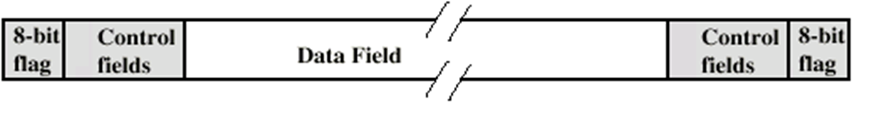
Synchronous Transmission
Fig. shows a typical format for synchronous transmission.
The preamble is flag which is 8-bits.postamble is the same.
The receiver looks for the preamble to signal the start of the frame.
The preamble is followed by some no of control fields.

